Slide 1
Epigenetics

Slide 2
EPIGENETICS
the study of phenomena and mechanisms that cause chromosome-bound, heritable (both mitotically and/or meiotically) changes to gene expression that are not dependent on changes to DNA sequence (sensu Deans & Maggert 2015).
broader sense of “epigenetics” - long term alterations in the transcriptional potential of a cell that are not necessarily heritable (see Metzger & Schulte 2016).

Slide 3
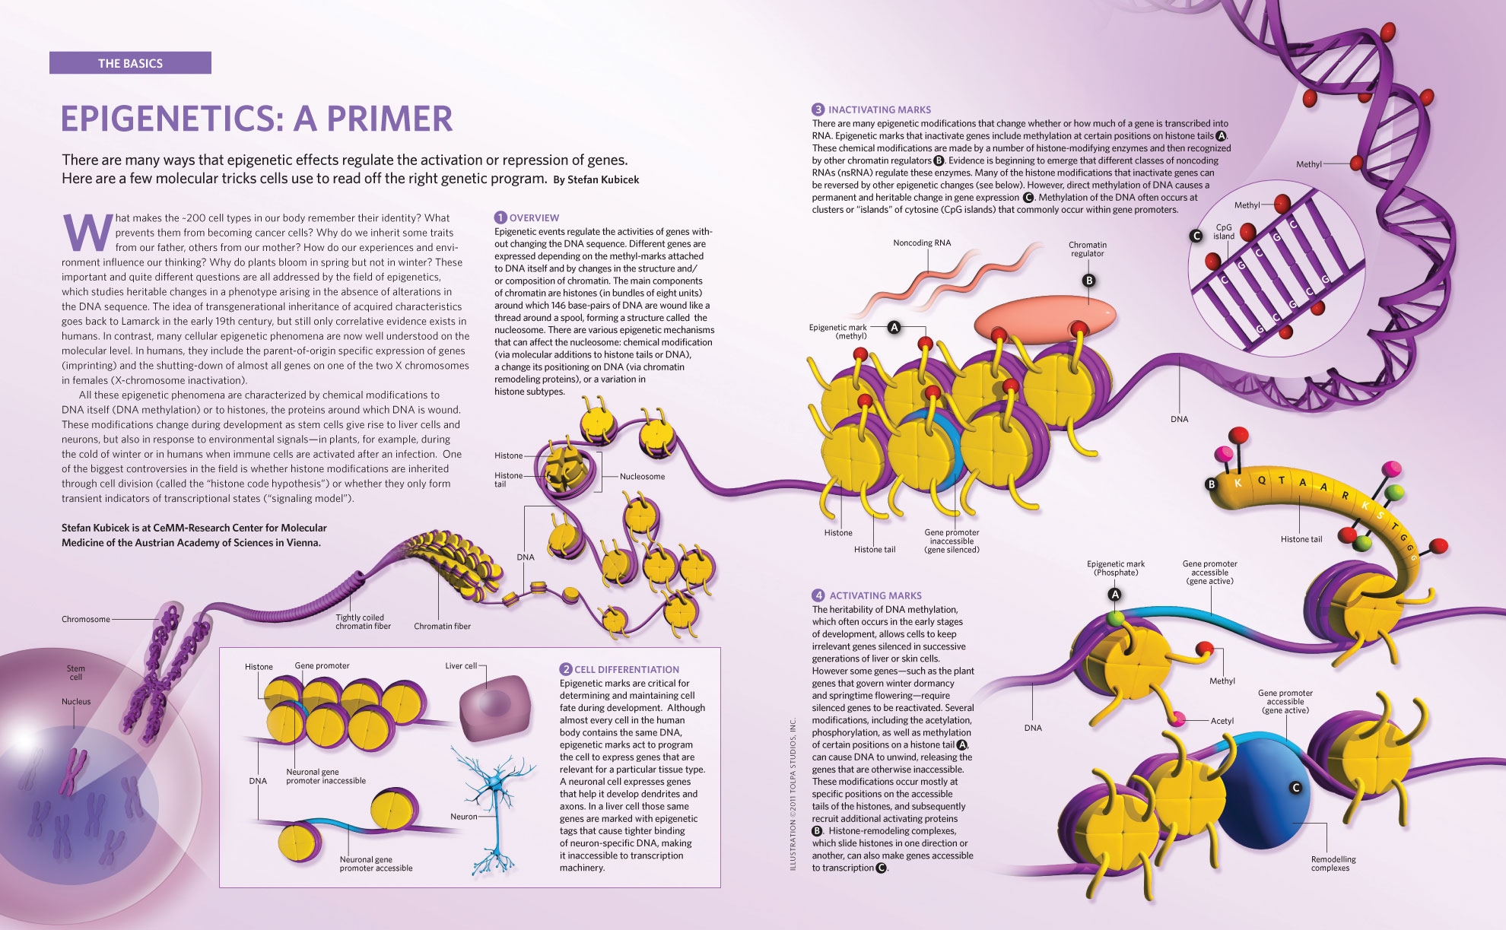
EPIGENETIC MECHANISMS
https://photos.the-scientist.com/content/images/articles/58007/epigenetics_primer.jpg

Slide 4
ACCLIMATIZATION
Bossdorf et al. 2008

Slide 5
EPIGENETIC MECHANISMS
Eirin-Lopez and Putnam in review

Slide 6
Eirin-Lopez and Putnam in review

Slide 7
EPIGENETIC MECHANISMS
https://photos.the-scientist.com/content/images/articles/58007/epigenetics_primer.jpg

Slide 8
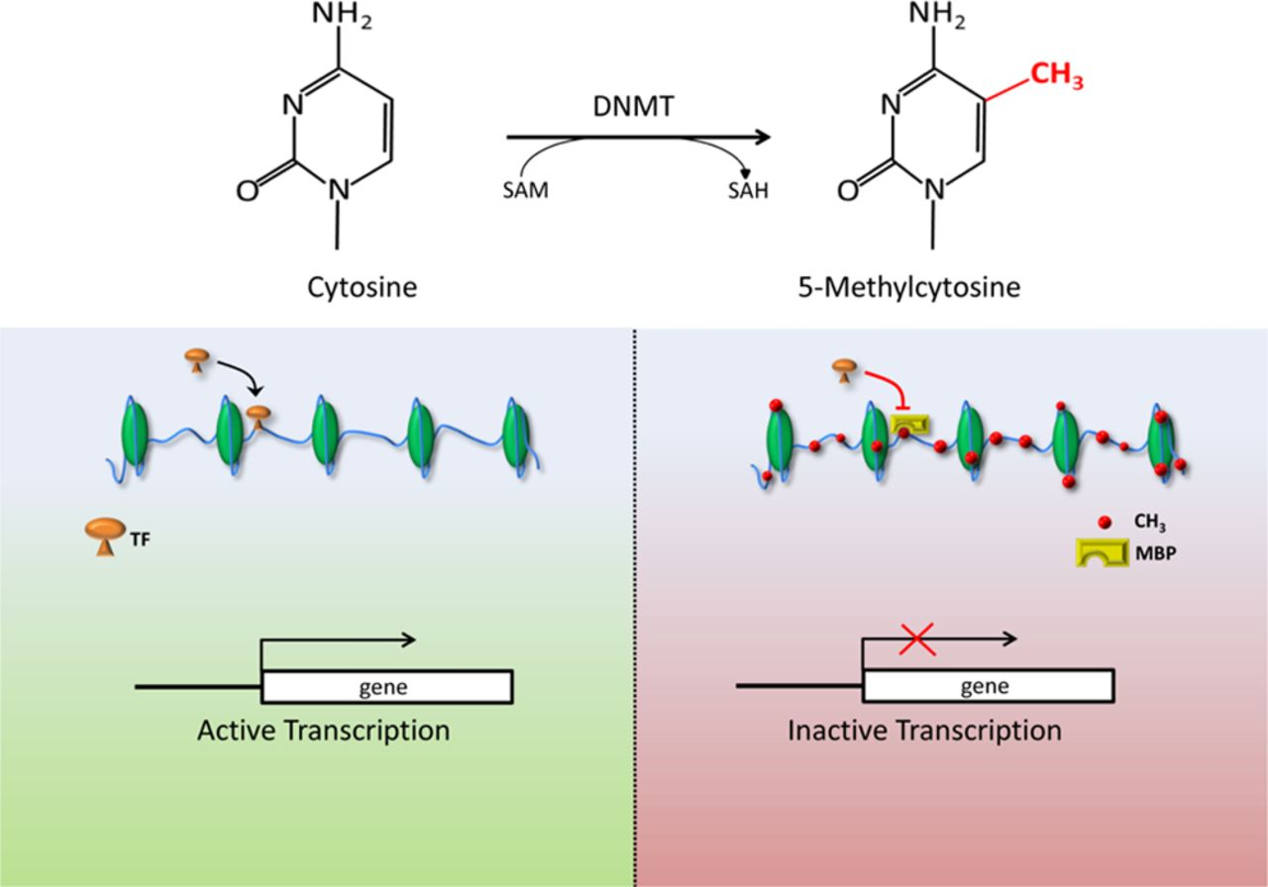
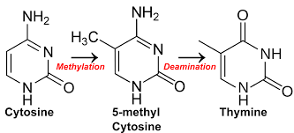
EPIGENETIC CONTROL OF GENE EXPRESSION
EPIGENETICS
DNA
Methylation
DNA Methylation Expression Regulation:
interactions of the methyl group with the major groove of the DNA helix to enhance or block DNA binding proteins
methylated CPG recruitment of methyl binding domain proteins, which in turn can generate a repressive chromatin state
http://circres.ahajournals.org/content/118/1/119

Slide 9
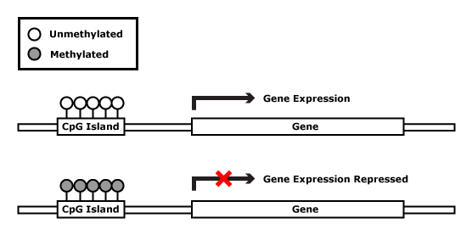
EPIGENETICS - DNA METHYLATION
Common
Vertebrate
Expression
Regulation
Potential
Invertebrate
Expression
Regulation
Roberts and Gavery 2012

Slide 14
DNA METHYLATION - IN SILICO ANALYSIS
Cytosine Methylation & Deamination
Cytosine Phosphate Guanine observed/expected ratio
Gavery and Roberts 2010

Slide 15
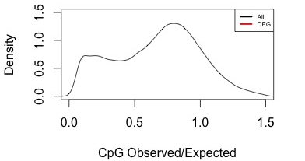
DNA METHYLATION - IN SILICO ANALYSIS
Cytosine Methylation & Deamination
Cytosine Phosphate Guanine observed/expected ratio
Gavery and Roberts 2010
Housekeeping
Genes
Environmentally
Responsive
Genes
Strong Methylation = Low CpGo/e
Weak Methylation = High CpGo/e

Slide 16
DNA METHYLATION - IN SILICO ANALYSIS
Cytosine Methylation & Deamination
Cytosine Phosphate Guanine observed/expected ratio
Environmentally responsive genes have weak/dynamic methylation
Gavery and Roberts 2010
Housekeeping
Genes
Environmentally
Responsive
Genes
Strong Methylation = Low CpGo/e
Weak Methylation = High CpGo/e

Slide 17
DNA METHYLATION - IN SILICO ANALYSIS
Cytosine Methylation & Deamination
Cytosine Phosphate Guanine observed/expected ratio
Environmentally responsive genes have weak/dynamic methylation
Gavery and Roberts 2010
Dimond and Roberts 2015
Strong Methylation = Low CpGo/e
Weak Methylation = High CpGo/e

Slide 19
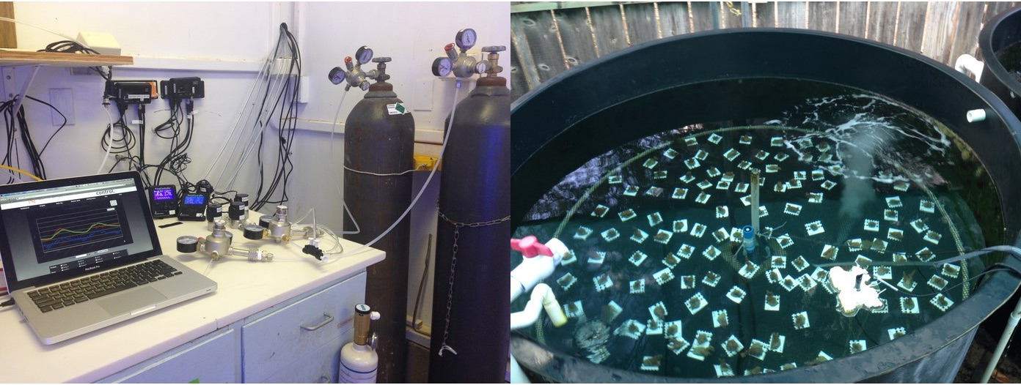
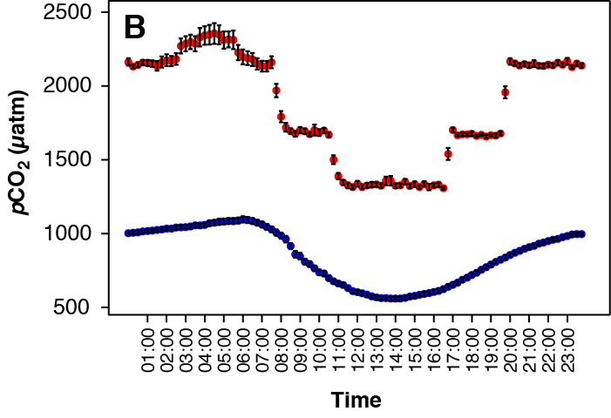
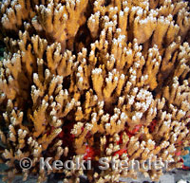
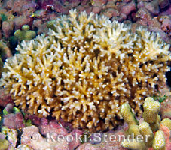
PLASTICITY AND DNA METHYLATION
Experimental Exposure:
6 week exposure of clonal fragments
M. capitata and P. damicornis
Response variables:
Cellular Phenotype - Metabolomics (¹H-NMR)
Growth - Buoyant weight
DNA Methylation - spectrophotometric MDIP
Montipora capitata
Pocillopora damicornis

Slide 20
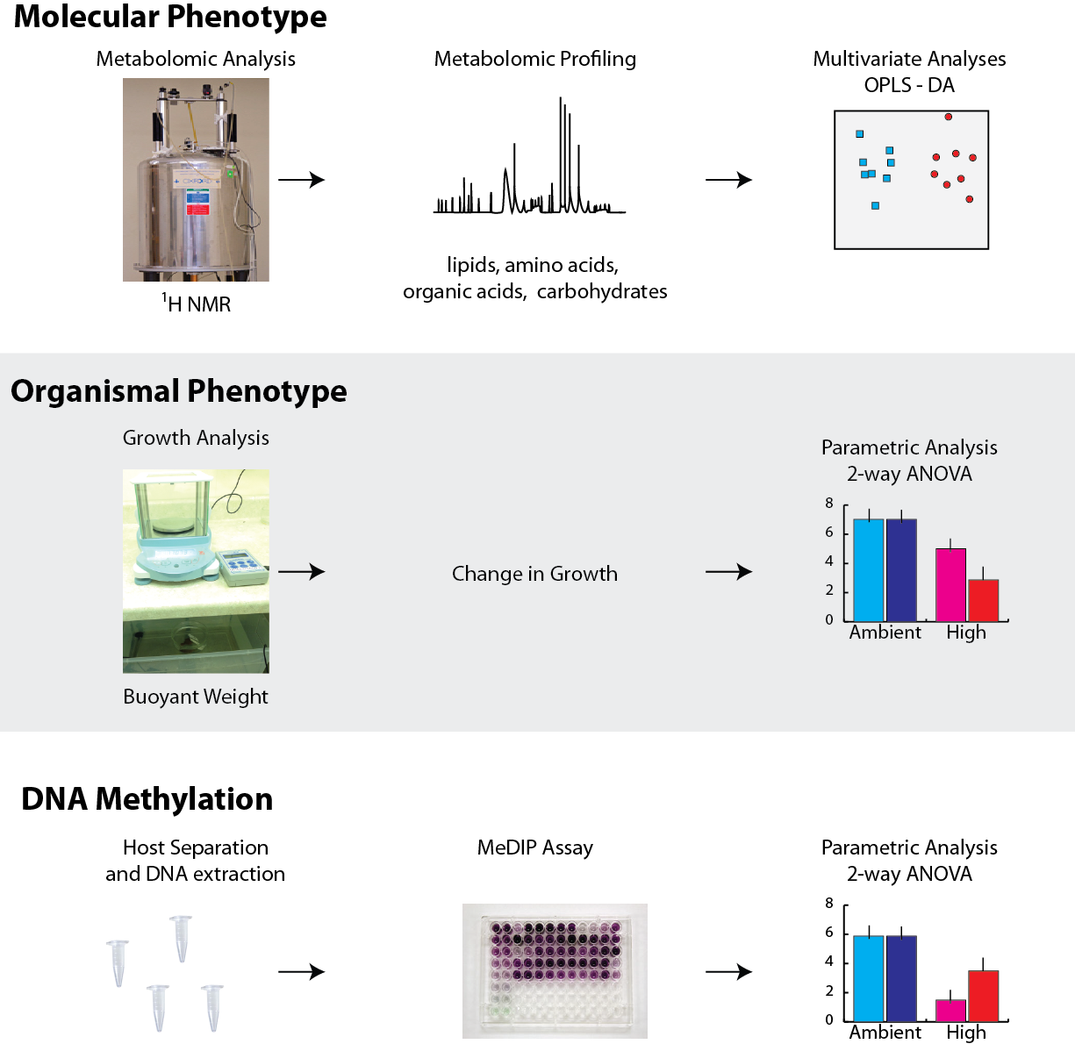
ASSESSING PLASTICITY AND METHYLATION

Slide 21
PLASTICITY IN METABOLOMIC PROFILES
Q²=0.788, p < 0.01
Q²=0.153, p < 0.01
Q²=0.353, p < 0.01
Q² represents model accuracy and
p value tests against null distribution
Putnam et al 2016

Slide 22
PLASTICITY IN METABOLOMIC PROFILES
Q²=0.788, p < 0.01
Q²=0.153, p < 0.01
Q²=0.353, p < 0.01
Q² represents model accuracy and
p value tests against null distribution
Putnam et al 2016

Slide 23
PLASTICITY IN METABOLOMIC PROFILES
Q²=0.788, p < 0.01
Q²=0.153, p < 0.01
Q²=0.353, p < 0.01
Q² represents model accuracy and
p value tests against null distribution
Putnam et al 2016

Slide 24
PLASTICITY IN GROWTH
Q²=0.788, p < 0.01
Q²=0.153, p < 0.01
Q²=0.353, p < 0.01
S: p < 0.0001
T: p<0.01
Putnam et al 2016

Slide 25
PLASTICITY AND DNA METHYLATION
Q²=0.788, p < 0.01
Q²=0.153, p < 0.01
Q²=0.353, p < 0.01
S: p < 0.0001
T: p<0.01
SxT: p=0.04
Putnam et al 2016

Slide 26
PLASTICITY AND DNA METHYLATION
Q²=0.788, p < 0.01
Q²=0.153, p < 0.01
Q²=0.353, p < 0.01
Dynamic DNA methylation is linked to greater phenotypic plasticity
S: p < 0.0001
T: p<0.01
SxT: p=0.04
Putnam et al 2016

Slide 27
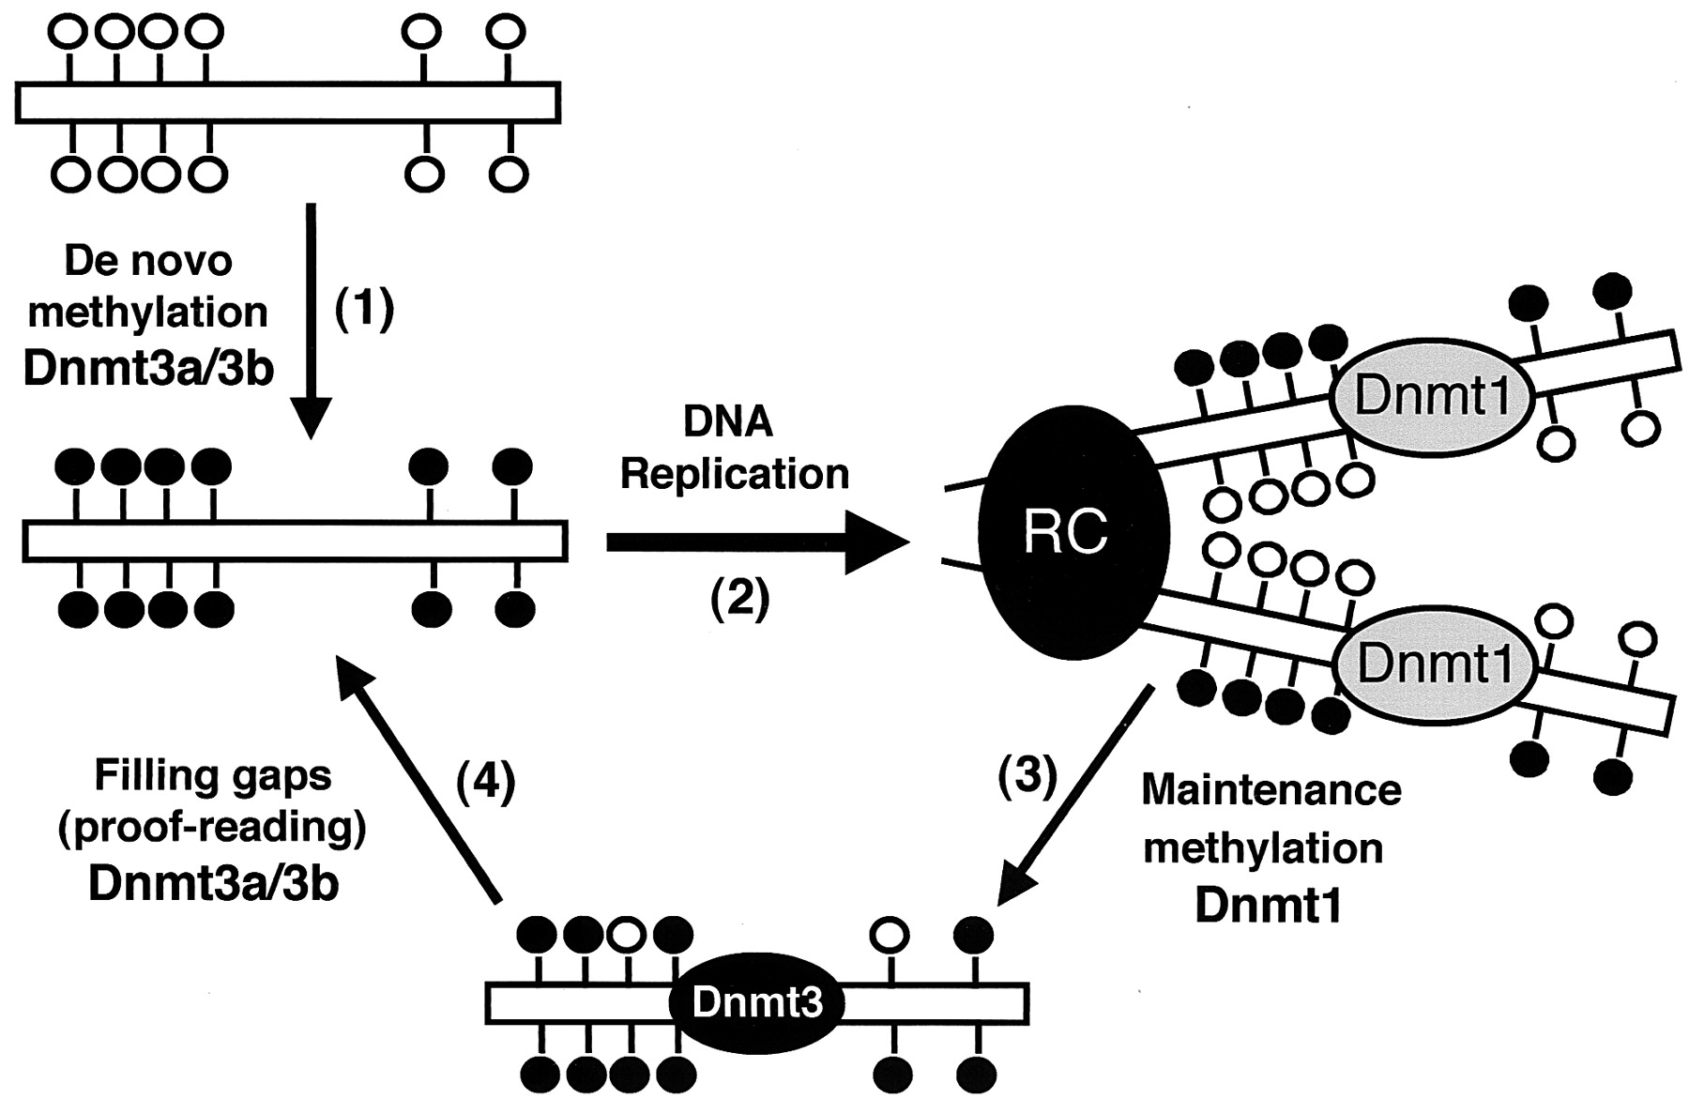
HERITABILITY OF DNA METHYLATION
Taiping Chen et al. Mol. Cell. Biol. 2003;23:5594-5605

Slide 28
HERITABILITY OF DNA METHYLATION
Taiping Chen et al. Mol. Cell. Biol. 2003;23:5594-5605

Slide 30
Paired ddRAD and EpiRAD
Both methods used the rare cutter PstI (5’-CTGCAG-3’ recognition site), while the common cutter MspI (5’-CCGG-3’ recognition site) was used for ddRADseq and the methylation-sensitive isoschizomer HpaII (also 5’ -CCGG-3’ recognition site) was used for EpiRADseq preparations.
“Methylation detection with EpiRADseq data involves analysis of read counts (Schield et al., 2016). The presence of a given read in the EpiRADseq data set indicates that the locus is not methylated at the restriction cut site. Conversely, if a locus is methylated at the 5’- CCGG-3’ cut site, HpaII is blocked from cutting, and the locus will be absent from the data set.”
Dimond and Roberts 2017 Molec Ecol

Slide 32
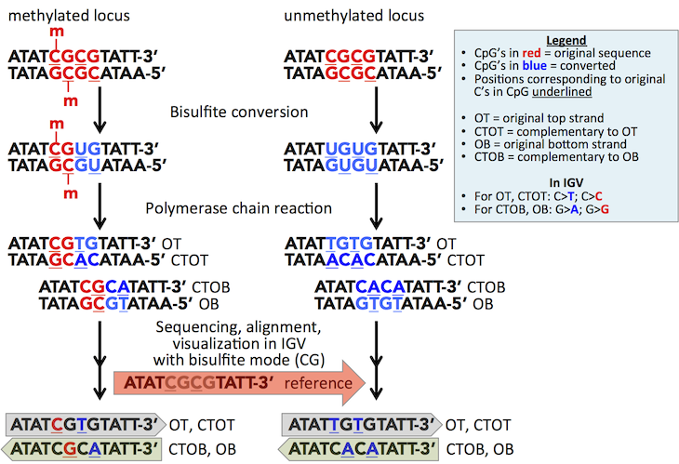
BISULFITE CONVERSION

Slide 33
Working with WGBS Data
Extract DNA, add unmethylated phage DNA spike
Convert DNA
Prep Library and sequence
Download and check checksum
Obtain Reference Genome files (target and phage)
Prepare reference genomes
bisulfite-converted forward (C->T) and reverse read (G->A conversion of the forward strand) versions so reads will map
QC Raw Data Files

Slide 34
Working with WGBS Data
Trim Adapters
Map to genomes
Calculate conversion rates
Deduplicate Data
Extract methylation genome wide C report
Filter based on coverage (5x or 10x)
Compare to genome tracks
Location, expression, expression variation, alternative splicing

Slide 35
EPIGENETICS - DNA METHYLATION

Slide 36
Working with WGBS Data
Extract DNA, add unmethylated phage DNA spike
Convert DNA
Prep Library and sequence
Download and check checksum
Obtain Reference Genome files (target and phage)
Prepare reference genomes
bisulfite-converted forward (C->T) and reverse read (G->A conversion of the forward strand) versions so reads will map
QC Raw Data Files

Slide 37
W5 - https://abc.med.cornell.edu/pubshare/public/2/18f44270101d95db/Project_EC-HP-4550/Sample_W5/*.fastq.gz
2eb16aed52890081b0342b6b5b0d27e0f5a7353d Sample_W5/W5_S1_L001_R1_001.fastq.gz 6eb99aaafbbb3b6f114ed0d8efc8c5df8a9ca8d9 Sample_W5/W5_S1_L001_R2_001.fastq.gz
tar xvf W5.fastq.gz
W19 - https://abc.med.cornell.edu/pubshare/public/2/d90cfeeb5c0799d4/Project_EC-HP-4550/Sample_W19/W19_S2_L001_R1_001.fastq.gz
f3781f02ff63c66cd7d4e4d90391c527033f9f1e Sample_W19/W19_S2_L001_R1_001.fastq.gz 6e5abc95b8b89e61b3c1b132b525c77ceb12b3cc Sample_W19/W19_S2_L001_R2_001.fastq.gz
tar xvf W19.fastq.gz
sah1sum W*.gz
2eb16aed52890081b0342b6b5b0d27e0f5a7353d W5_S1_L001_R1_001.fastq.gz 6eb99aaafbbb3b6f114ed0d8efc8c5df8a9ca8d9 W5_S1_L001_R2_001.fastq.gz f3781f02ff63c66cd7d4e4d90391c527033f9f1e W19_S2_L001_R1_001.fastq.gz 6e5abc95b8b89e61b3c1b132b525c77ceb12b3cc W19_S2_L001_R2_001.fastq.gz

Slide 38
Working with WGBS Data
Extract DNA, add unmethylated phage DNA spike
Convert DNA
Prep Library and sequence
Download and check checksum
Obtain Reference Genome files (target and phage)
Prepare reference genomes
bisulfite-converted forward (C->T) and reverse read (G->A conversion of the forward strand) versions so reads will map
QC Raw Data Files

Slide 39
Genome Preparation
Obtain Mcap Genome file
PacBio 20170313.mcap.falcon.errd.fasta.gz
Run Bismark Genome preparation
~/programs/Bismark-0.18.2/bismark_genome_preparation ~/Mcap_WGBS/Mcap_Genome

Slide 40
Working with WGBS Data
Extract DNA, add unmethylated phage DNA spike
Convert DNA
Prep Library and sequence
Download and check checksum
Obtain Reference Genome files (target and phage)
Prepare reference genomes
bisulfite-converted forward (C->T) and reverse read (G->A conversion of the forward strand) versions so reads will map
QC Raw Data Files

Slide 41
~/programs/FastQC/fastqc /home/hputnam/Mcap_WGBS/Samples/*.fastq.gz -o ~/Mcap_WGBS/Genome_Compare/Raw_QC_Files

Slide 42
MULTIQC
Where do we expect these files to fail QC?

Slide 43
Working with WGBS Data
Trim Adapters
Map to genomes
Calculate conversion rates
Deduplicate Data
Extract methylation genome wide C report
Filter based on coverage (5x or 10x)
Compare to genome tracks
Location, expression, expression variation, alternative splicing

Slide 44
Trimming Considerations
~/programs/cutadapt-1.8.3/bin/cutadapt -a AGATCGGAAGAGC -q 30 -o ~/Mcap_WGBS/Genome_Compare/Trimmed/W5_R1.trimmed.fastq.gz ~/Mcap_WGBS/Samples/W5_S1_L001_R1_001.fastq.gz
Consider how your libraries are prepped

Slide 45
RRBS specific Considerations on Trimming
“RRBS is a specialised technique to only look at CpG rich regions of the genome by using the restriction enzyme MspI (please see this RRBS Guide for some more specifics regarding data processing). For reasons explained in the RRBS-guide, the second last position of all reads before reading into the Illumina adapter exhibits an artificially (not methylated) methylation state as a result of the end-repair reaction. The option --rrbs within Trim Galore removes 2 extra bases whenever adapter contamination has been detected. This 3' end trimming that needs to be carried out for single-end runs or Read 1 of paired-end libraries. Read 2 of paired-end libraries is however not affected by this 3' bias, but instead the first couple of positions on the 5' end of Read 2 suffer from the read-through problem as Read 1 (Read 2 is a mere copy of Read 1), so Read 2 needs to have the first 2 bp removed instead. As of the current development version of Trim Galore (v0.4.2_dev; 12/16/2016) the option --rrbs removes:
2 bp from the 3' end of single-end and Read 1 of paired-end reads in addition to adapter contamination, and
2 bp from the 5' end of Read 2 of paired-end reads”

Slide 46
Working with WGBS Data
Trim Adapters
Map to genomes
Calculate conversion rates
Deduplicate Data
Extract methylation genome wide C report
Filter based on coverage (5x or 10x)
Compare to genome tracks
Location, expression, expression variation, alternative splicing

Slide 47
Mapping to Genome
Bismark call using Bowtie 2 mapping - test parameters
~/programs/Bismark-0.18.2/bismark --genome ~/Mcap_WGBS/Mcap_Genome/ -1 ~/Mcap_WGBS/Genome_Compare/Trimmed/W5_R1.trimmed.fastq.gz -2 ~/Mcap_WGBS/Genome_Compare/Trimmed/W5_R2.trimmed.fastq.gz
Defaults, 27.4% mapping
~/programs/Bismark-0.18.2/bismark --genome ~/Mcap_WGBS/Mcap_Genome/ --bowtie2 --score_min L,0,-0.6 -1 ~/Mcap_WGBS/Genome_Compare/Trimmed/W19_R1.trimmed.fastq.gz -2 ~/Mcap_WGBS/Genome_Compare/Trimmed/W19_R2.trimmed.fastq.gz -p 12 --bam
Change --score_min, 62.8.4% mapping
~/programs/Bismark-0.18.2/bismark --genome ~/Mcap_WGBS/Mcap_Genome/ --bowtie2 --score_min L,0,-0.9 -1 ~/Mcap_WGBS/Genome_Compare/Trimmed/W5_R1.trimmed.fastq.gz -2 ~/Mcap_WGBS/Genome_Compare/Trimmed/W5_R2.trimmed.fastq.gz -p 12 --bam
Defaults, 65.9% mapping
--score_min
Sets a function governing the minimum alignment score needed for an alignment to be considered “valid” (i.e. good enough to report). This is a function of read length. For instance, specifying L,0,-0.6 sets the minimum-score function f to f(x) = 0 + -0.6 * x, where x is the read length.

Slide 48
Working with WGBS Data
Trim Adapters
Map to genomes
Calculate phage conversion rates - expected ?
Deduplicate Data
Extract methylation genome wide C report
Filter based on coverage (5x or 10x)
Compare to genome tracks
Location, expression, expression variation, alternative splicing

Slide 49
Working with WGBS Data
Trim Adapters
Map to genomes
Calculate phage conversion rates - expected ?
Deduplicate Data
Extract methylation genome wide C report
Filter based on coverage (5x or 10x)
Compare to genome tracks
Location, expression, expression variation, alternative splicing

Slide 50
Deduplication
Goal is to reduce PCR artifacts or duplicated seqeunces, which is important given count data
~/programs/Bismark-0.18.2/deduplicate_bismark ~/Mcap_WGBS/Genome_Compare/Mapped/R1.trimmed_bismark_bt2_pe.bam

Slide 51
Working with WGBS Data
Trim Adapters
Map to genomes
Calculate phage conversion rates - expected ?
Deduplicate Data
Extract methylation - genome wide C report
Filter based on coverage (5x or 10x)
Compare to genome tracks
Location, expression, expression variation, alternative splicing

Slide 52
Extract Methylation Information
Generate a report for every C in the genome
~/programs/Bismark-0.18.2/bismark_methylation_extractor --gzip -p --ignore_r2 2 --scaffolds --bedGraph --zero_based --no_overlap --multicore 20 --buffer_size 20G --cytosine_report --report --genome_folder ~/Mcap_WGBS/Mcap_Genome/ ~/Mcap_WGBS/Genome_Compare/DeDup/R1.trimmed_bismark_bt2_pe.deduplicated.sam

Slide 53
Extract Methylation Information
where H correspond to A, T or C

Slide 54
Working with WGBS Data
Trim Adapters
Map to genomes
Calculate phage conversion rates - expected ?
Deduplicate Data
Extract methylation - genome wide C report
Filter based on coverage (5x or 10x)
Compare to genome tracks
Location, expression, expression variation, alternative splicing

Slide 55
Liew et al 2018 preprint

Slide 56
Resources for Non-model BS seq
https://github.com/sr320
https://github.com/lyijin/working_with_dna_meth
https://github.com/FelixKrueger/Bismark

Slide 57
Epigenetic Mechanisms

